Slide 1
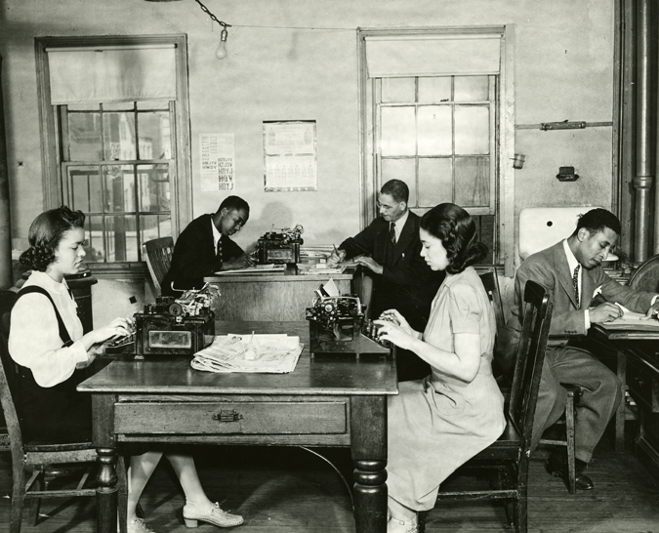
THE STRUGGLE FOR CIVIL RIGHTS IN NEW JERSEY
1948-2020
75 Years of the Law Against Discrimination

Slide 2
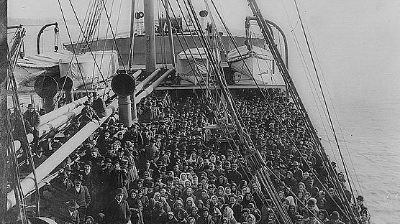
1884
Law passed prohibiting discrimination based on race, color or previous condition of servitude. Discrimination continued to persist based on local practices rather than law.
Notes:
1884
Law passed prohibiting discrimination based on race, color or previous condition of servitude. Discrimination continued to persist based on local practices rather than law.

Slide 3
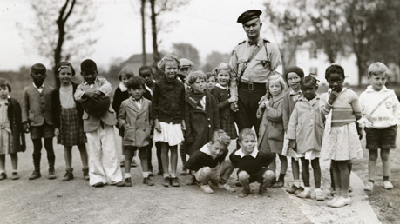
1938
Between 1884 and 1945 New Jersey passed 10 bills relating to discrimination; some strengthening the law, some making it weaker. In 1938 a Goodwill Commission was established to “bring about a better understanding among all racial and religious groups.”

Slide 4
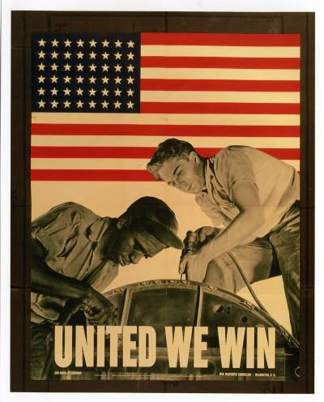
Fighting fascism abroad during World War II intensified demands for equality at home from the NAACP and progressive political groups like the Independent Citizens League.

Slide 5
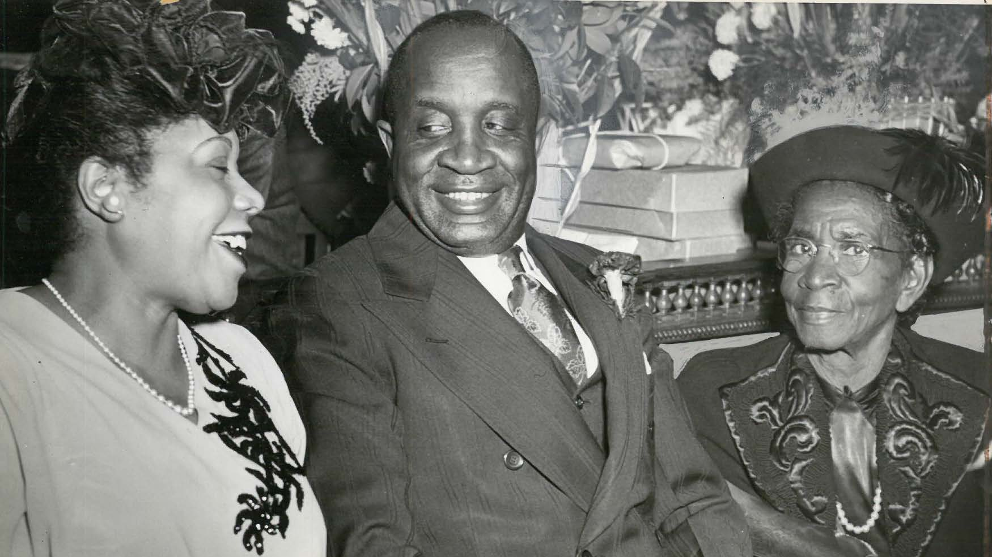
1945
Dr. Hill, a Republican assemblyman from Essex County, was responsible for introducing the Law Against Discrimination bill that was unanimously approved by the legislature and signed by Governor Edge.

Slide 6
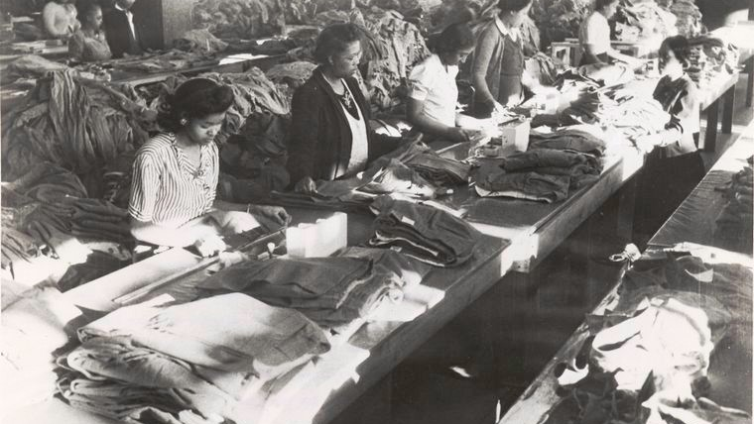
The new law created the Division Against Discrimination and broadened all civil rights laws to include “creed, national origin or ancestry” and banned racial discrimination in employment.

Slide 7
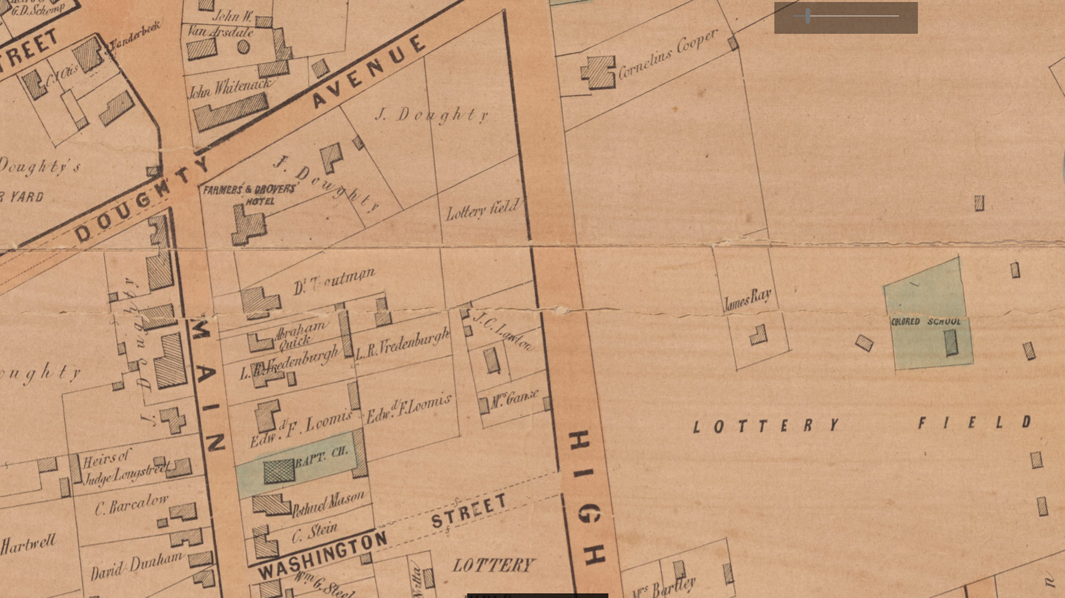
1947
The new constitution contained a civil rights clause banning segregation in the State Militia and in public schools. At the time there were 43 school districts with white and black segregated elementary schools.

Slide 8
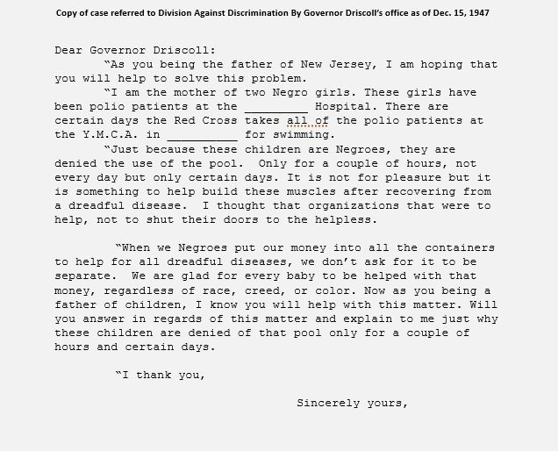
1949
The 1949 New Jersey Civil Rights Act reinforced and extended the bans on segregation or discrimination in public places such as pools, roller rinks and dance halls.

Slide 9
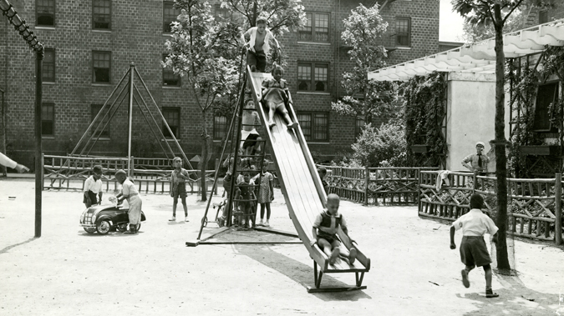
  1950
Discrimination in housing built with public funds or public assistance based on race, creed, color national origin or ancestry was outlawed

Slide 10
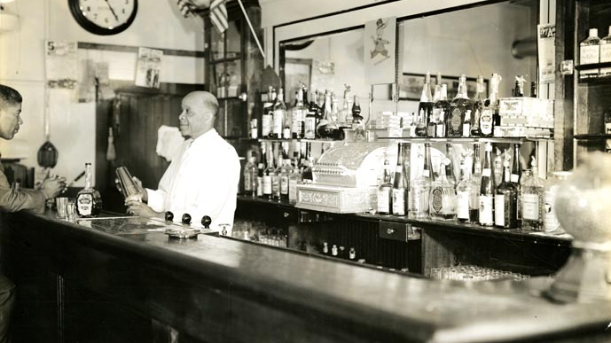
1960
The Law Against Discrimination was amended to outlaw discrimination based on age – age can not be used as a reason to not get or keep a job.

Slide 11
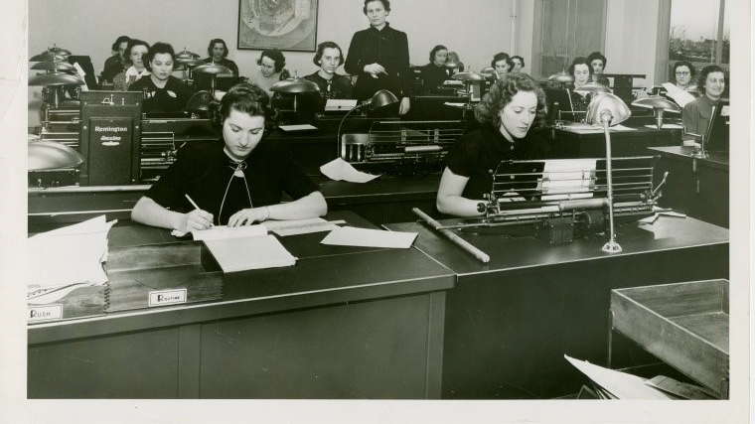
1970
Discrimination based on sex and marital status outlawed. No longer could women be forced out of a job once they married.

Slide 12

1972
Law amended to include people with disabilities. In 1979 the definition was expanded to include non-physical disabilities.

Slide 13
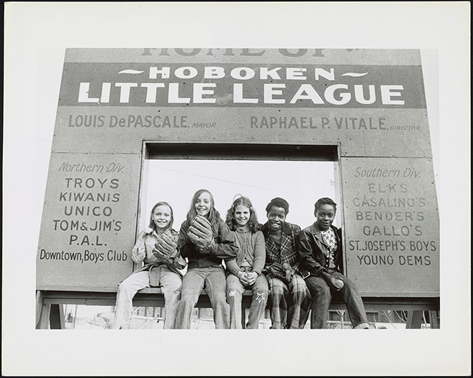
1974
National Organization for Women (NOW) v. Little League Baseball
In 1972, 12-year old Maria Pepe was kicked off of a Little League team in Hoboken because of Little League’s policy of only allowing boys to compete. The New Jersey Supreme Court affirmed a determination by Division on Civil Rights finding that girls should be permitted to play Little League baseball. By the next year, more than 30,000 girls played on Little League teams nationwide.

Slide 14
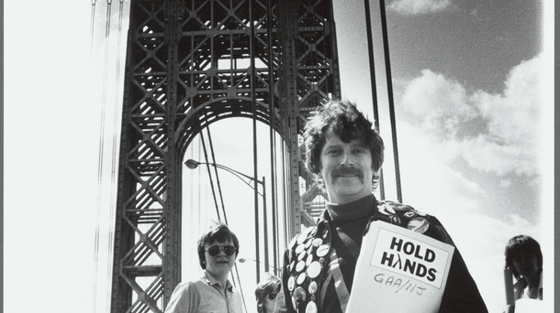
1992
After decades of activism New Jersey became one of a handful of states to protect individuals based on sexual orientation.

Slide 15

2006
The Law Against Discrimination was amended to add prohibitions against discrimination on the basis of gender identity or expression.

Slide 16

2007
The Law Against Discrimination was amended to require employers to reasonably accommodate their employee’s religious beliefs

Slide 17
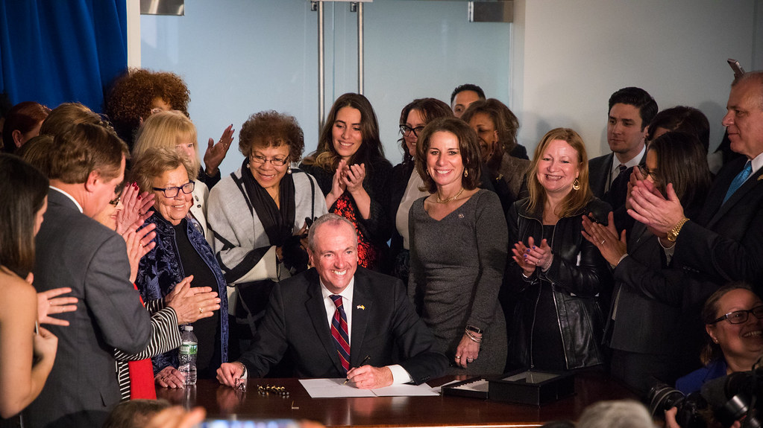
2017
The Diane B. Allen Equal Pay Act amended the LAD to require equal pay for “substantially similar work” for those in protected categories
giving NJ the strongest equal pay law in the nation at the time.

Slide 18

In recognizing the humanity of our fellow beings, we pay ourselves the highest tribute.
Thurgood Marshall

